Slide 1

X Education - Lead Scoring Case Study
Group Members:
Sanket sanjay kendre
Sanjeev Rout
Sakshi Jha

Slide 2
Background: X education company
X Education , An education company named sells online courses to industry professionals
Many interested professionals land on their website
The company markets its courses on several websites like Google. Once these people land on the website, they might browse the courses or fill up a form for the course or watch some videos
When these people fill up a form providing their email address or phone number, they are classified to be a lead
Once these leads are acquired, employees from the sales team start making calls, writing emails, etc. Through this process, some of the leads get converted while most do not
The typical lead conversion rate at X education is around 30%

Slide 3
Problem Statement
X Education gets a lot of leads but its lead conversion rate is very poor
To make this process more efficient, the company wishes to identify the most potential leads, also known as ‘Hot Leads’
If they successfully identify this set of leads, the lead conversion rate should go up as the sales team will now be focusing more on communicating with the potential leads rather than making calls to everyone
We will help them to select the most promising leads, i.e. the leads that are most likely to convert into paying customers.
We are required to build a model wherein we need to assign a lead score to each of the leads such that the customers with higher lead score have a higher conversion chance
The CEO, in particular, has given a ballpark of the target lead conversion rate to be 80%.

Slide 4
Proposed Solution
Leads Clustering: Selection of hot leads
We cluster the leads into certain categories based on their tendency or probability to convert, thus, getting a smaller section of hot leads to focus more on.
Focus Communication: communication with hot leads
Since we would have a smaller set of leads to have communication with, we might make more impact with effective communication.
Increase conversion: conversion of hot leads
Since we focused on hot leads, which were more probable to convert, we would have a better conversion rate, and hence we can achieve the 80% target.

Slide 5

Implementation
Loading & Observing the past data provided by the Company
Univariate, Bivariate, and Heatmap for numerical and categorical columns
Performing pre-requisites for RFE and Logistic Regression
Data Gathering
Data Cleaning
Performing EDA
Data Preparation
Model Building
Duplicate removal, null value treatment, unnecessary column elimination, etc.
Outlier Treatment, Feature-Standardization
Selection of top 25 features using RFE
Reduction of columns and Model re-building
Verifying our Final Model Accuracy etc. with model built with PCA
Feature Selection
Model Building
Model Improvement
Final Model
Verifying with PCA
Model building using RFE for selected columns
Final Model Analysis and performance on Test Data

Slide 6
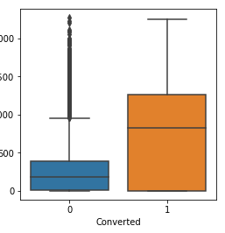
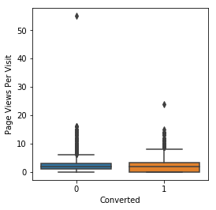
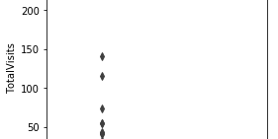
Plots (Visualization)
EDA plots depicting variation in numerical columns for those who Converted and those who didn't.

Slide 7
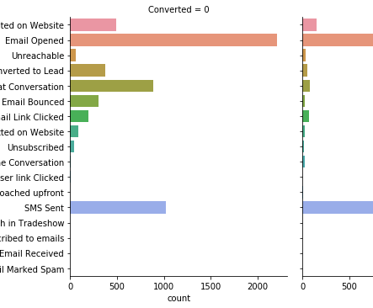
EDA plots depicting variation in categorical column (Last Activity) for those who Converted and those who didn't.

Slide 8
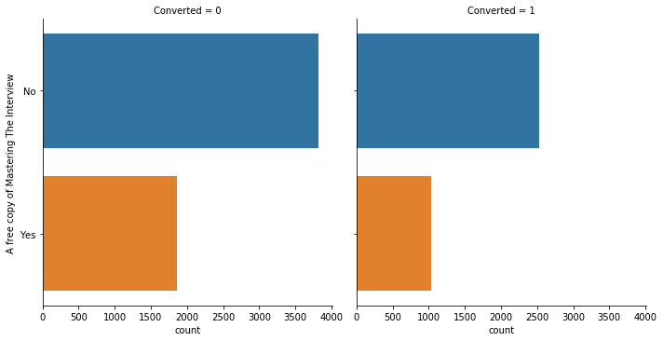
EDA plots depicting variation in categorical column (A free copy of Mastering The Interview) for those who Converted and those who didn't.

Slide 9
EDA plots depicting variation in categorical column (A free copy of Mastering The Interview) for those who Converted and those who didn't.

Slide 10
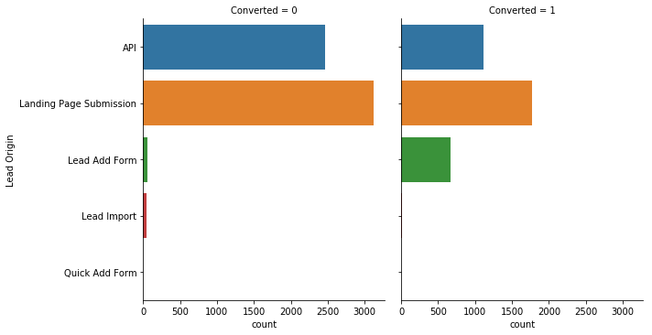
EDA plots depicting variation in categorical column (Lead Origin) for those who Converted and those who didn't.

Slide 11
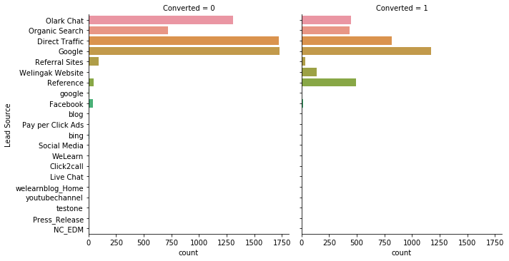
EDA plots depicting variation in categorical column (Lead Source) for those who Converted and those who didn't.

Slide 12
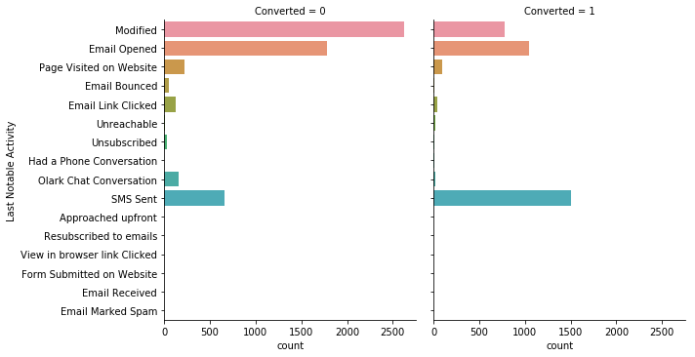
EDA plots depicting variation in categorical column (Last Notable Activity) for those who Converted and those who didn't.

Slide 13
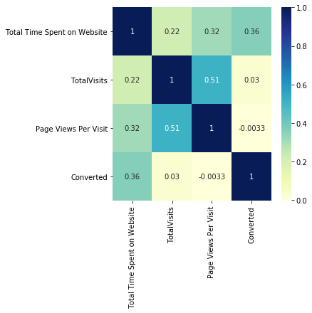
EDA plots depicting correlation (Heat Map) of all selected numerical columns.

Slide 14
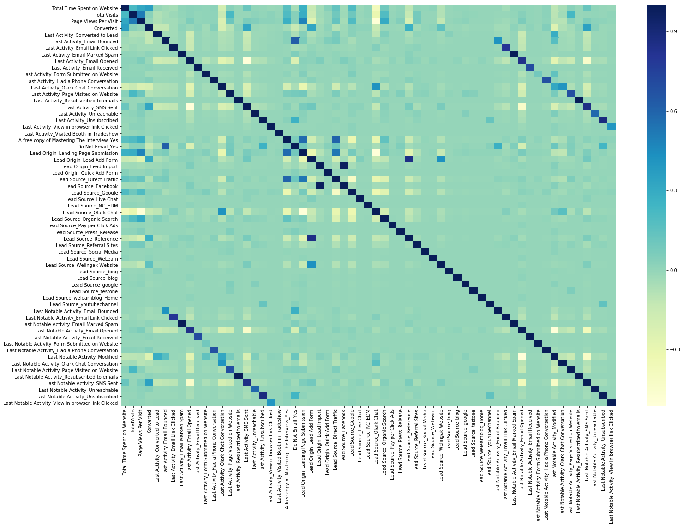
EDA plots depicting correlation (Heat Map) of all selected columns (numerical columns and dummy columns).

Slide 15
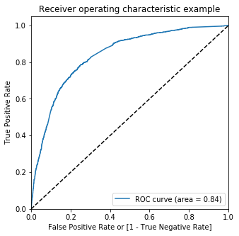
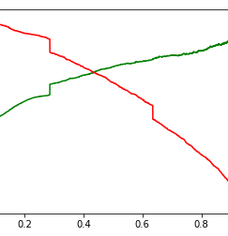
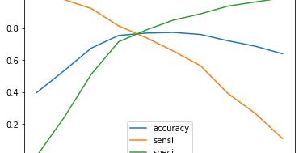
Linear Regression Final Model Parameters
Area under ROC = 0.84
Intermediate cut-off = 0.35
Final cut-off = 0.42

Slide 16
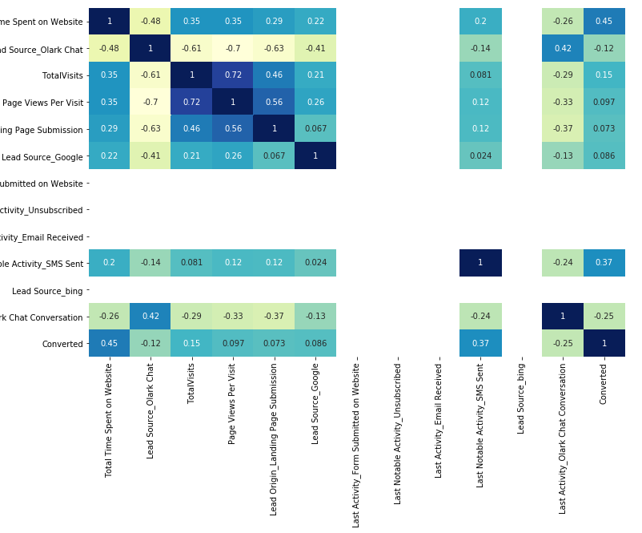
EDA plots depicting correlation (Heat Map) of all selected columns (numerical columns and dummy columns) in our final Model.

Slide 17
Inference / Conclusion
Model Analysis
Performance of our Final Mode
Overall accuracy on Test set: 0.786
Sensitivity of our logistic regression model: 0.733
Specificity of our logistic regression model: 0.823

Slide 18
Inferences from Model:Business Insights Derived from our Model
Top 3 variables in model, that contribute towards lead conversion are:
Total Time Spent on Website
Last Notable Activity_SMS Sent
TotalVisits
Top 3 variables in my model, that should be focused are:
Last Activity_SMS Sent (positively impacting)
Last Activity_Olark Chat Conversation (negatively impacting)
Lead Source_Olark Chat (negatively impacting)

Slide 19
Conclusion 1 (LR Model)
Our Logistic Regression Model performs well, achieving 78.6% accuracy, 73.3% sensitivity, and 82.3% specificity on the test set, which is comparable to the model derived using PCA.
By adjusting the cutoff value, we can fine-tune these parameters to better predict hot leads, depending on factors such as resource availability and other relevant scenarios.

Slide 20
Conclusion 2 (Recommendation)
To enhance the overall conversion rate, X Education Company should focus on the following key areas:
Boost user engagement on their website to drive higher conversion rates.
Increase the frequency of SMS notifications, as this contributes to better conversions.
Raise the number of total visits through advertising and other strategies, which supports higher conversion rates.
Improve the Olark Chat service, as current issues are negatively impacting conversions.

